Slide 1
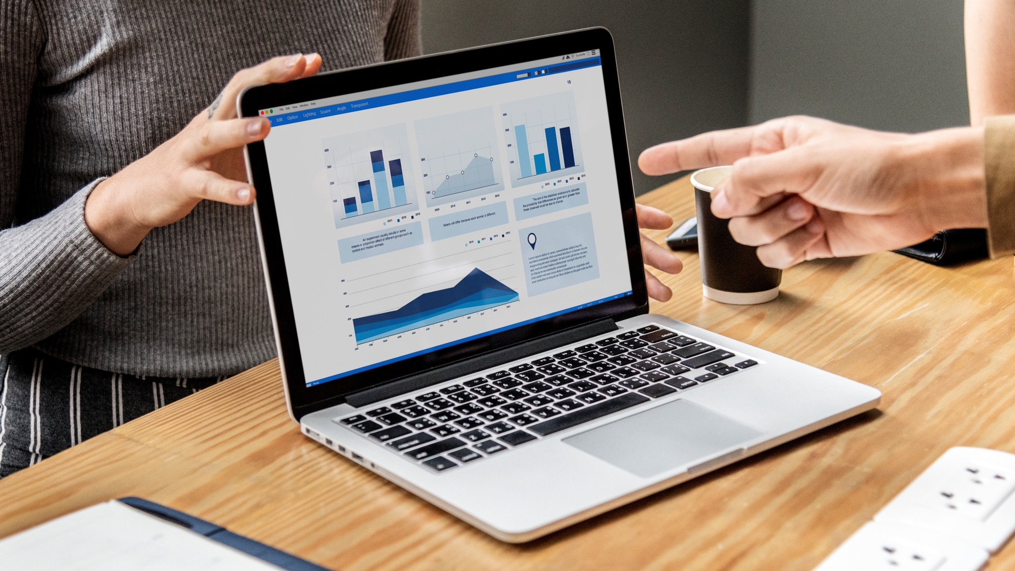
Wealth Advisory Data Analytics 360°
(Prioritized Meeting, Collaborate, AI Inferencing, Personalized Digital HNI Experience & GSI)

Slide 2
Business Problem
Solution Highlights
80% of Financial Advisors(FA) time goes for Meeting Preparation:
Gathering Market Data
Gathering client specific data
Deciding which client to meet based on above data
FA to answer HNI’s personalized queries ? Lack of RELEVANCE, CONTEXT, TIMING, & EMPATHY
What is the Portfolio impact on market research/market signals ?
What is the best product Mix suites for me in net new investment ? [Portfolio Optimization options, recommendations ]
How am I doing today (HNI) ? vs my peers [Anonymous peer-profile comparison and recommendations for HNIs?]
Dashboard Analytics & AI Inferencing:
Analyzing current market events
Analyzing the effect of such events on the client portfolio using AI
Displaying all relevant data in a single dashboard
Personalized Collaboration with HNI:
Audio, video, private meeting.
Co-browsing.
Document sharing.
Document annotation and eSign.
Comply with regulatory and risk requirement.
Custom workflow management for new product onboarding, and end-to-end order service fulfilment.
Unified Messaging & Customer Hub Integration: Realtime Advisory Support for FA, Portfolio highlights, external market event and signal notification, sentiments, cognitive search, specific client escalation management, enable omni-channel digital experience: Web, Mobile, Desktop between FA and HNIs.
Other Features Including:
AI powered Market Predictions based on market news.
Effect of such predictions on client portfolios.
AI powered prediction of client’s risk taking capability for better product marketing.
Advisory Bot to provide assistance to the Advisor relating to client or market data.
Benefits
40%
80%
50%
Revenue
Cross Sell
& Up Sell
FA Productivity
Meeting Prioritization
CX & Customer Retention

Slide 3
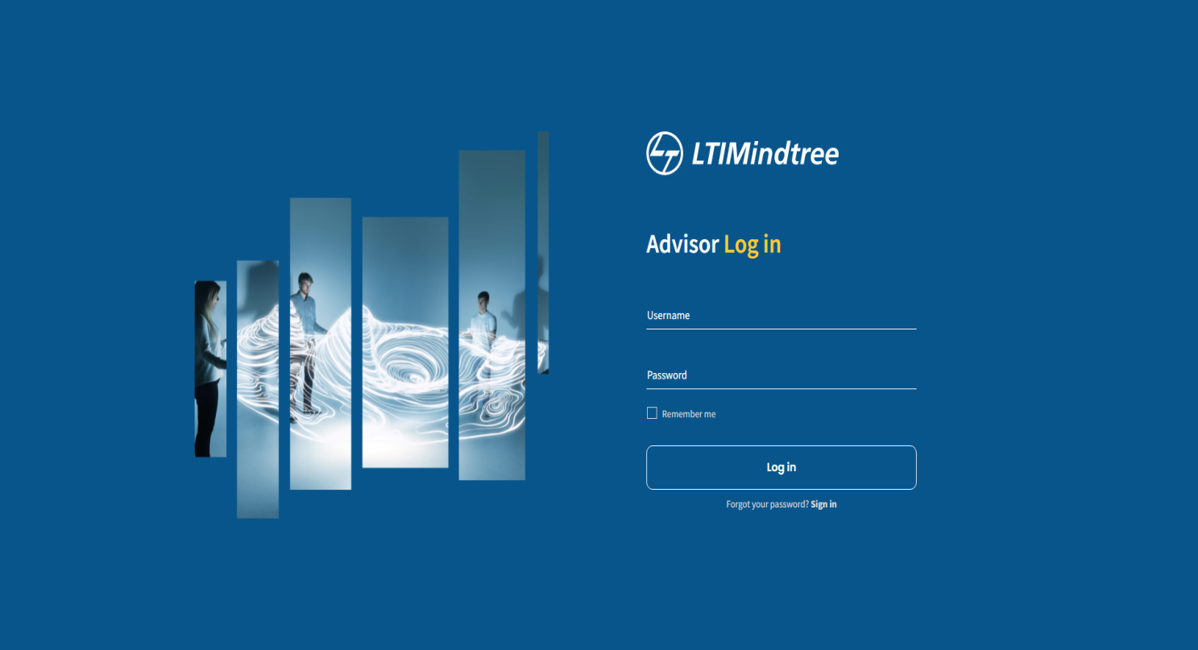
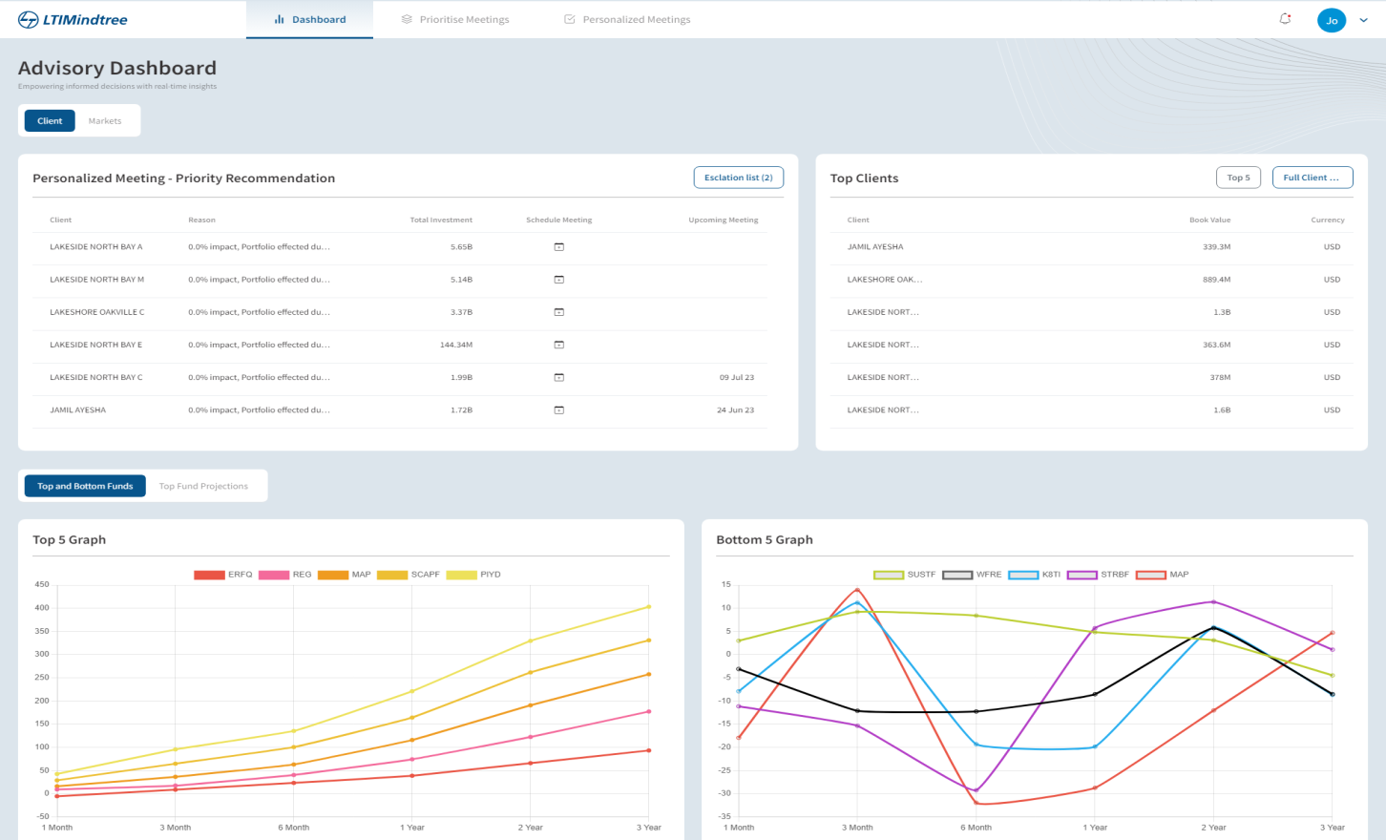
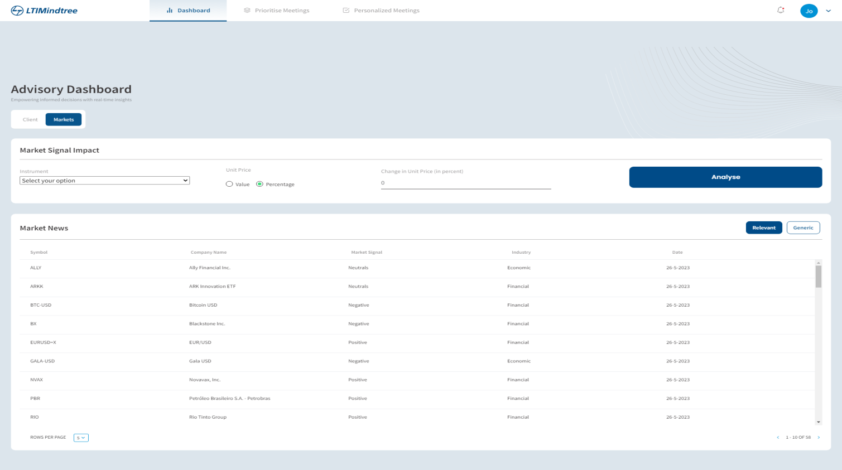
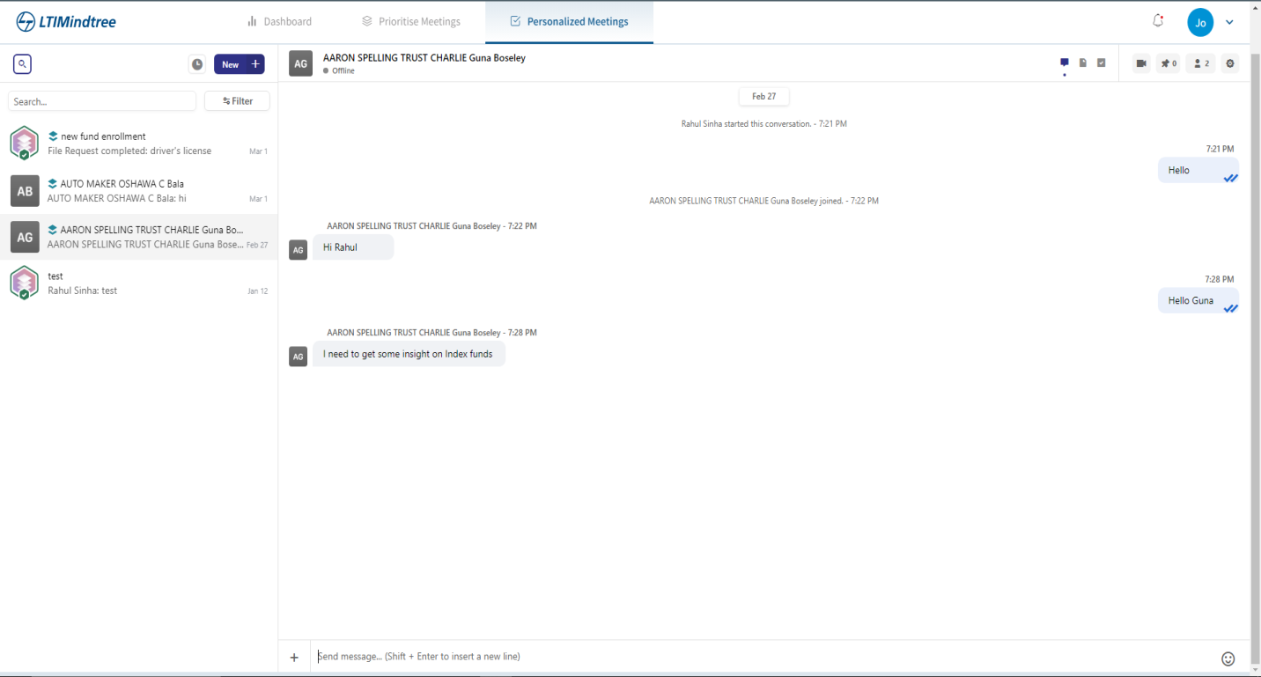
Solution Sneak Peek

